Slide 1
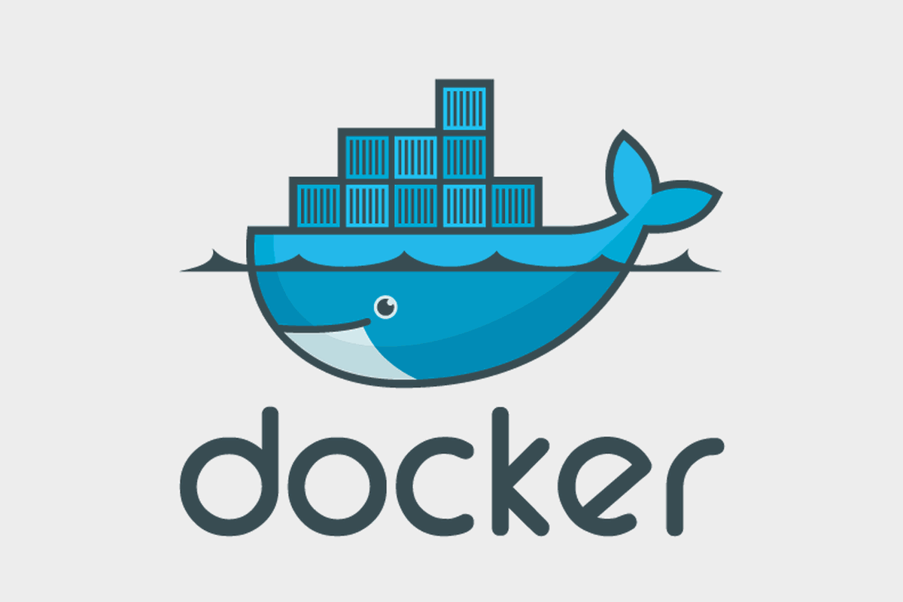

Slide 2

Agenda
Containers VS Virtual Machines
Container technology
Docker architecture
Docker Images
Docker Containers
Install Docker
Images Commands
Containers Commands
Conclusion

Slide 3
Agenda
Docker file basics & Sample
Building Docker file, tagging and creating image
Logging to your Docker repo from CLI
Pushing/Pulling image to docker repo
Day 2
Docker Volume
Docker Networking
Docker Compose
Docker Compose Basics
Docker Compose Commands

Slide 4
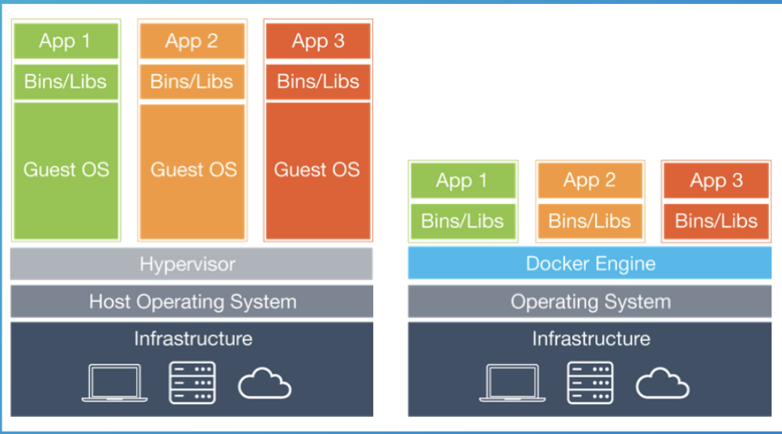
Virtual Machines VS Containers

Slide 5
Virtual Machines VS Containers
VMs | Containers
Heavyweight | Lightweight
Limited performance | Native performance
Each VM runs in its own OS (More secure and isolated) | All containers share the host OS
Slower Startup | Faster Startup
More memory is required | Fewer memory is required

Slide 6
Container technology
Namespaces
A namespace isolates specific system resources usually visible to all processes. Inside a
namespace, only processes that are members of that namespace can see those resources.
Namespaces can include resources like network interfaces, the process ID list, mount points, IPC resources, and the system's host name information.
Control groups (cgroups)
Control groups partition sets of processes and their children into groups to manage and limit the resources they consume. Control groups place restrictions on the amount of system resources processes might use. Those restrictions keep one process from using too many resources on the host.

Slide 7
Container History cont’d
Seccomp
Developed in 2005 and introduced to containers circa 2014, Seccomp limits how processes could use system calls. Seccomp defines a security profile for processes that lists the system calls, parameters and file descriptors they are allowed to use.
SELinux
Security-Enhanced Linux (SELinux) is a mandatory access control system for processes.
Linux kernel uses SELinux to protect processes from each other and to protect the host
system from its running processes. Processes run as a confined SELinux type that has limited access to host system resources

Slide 8
Docker architecture
Docker architecture

Slide 9
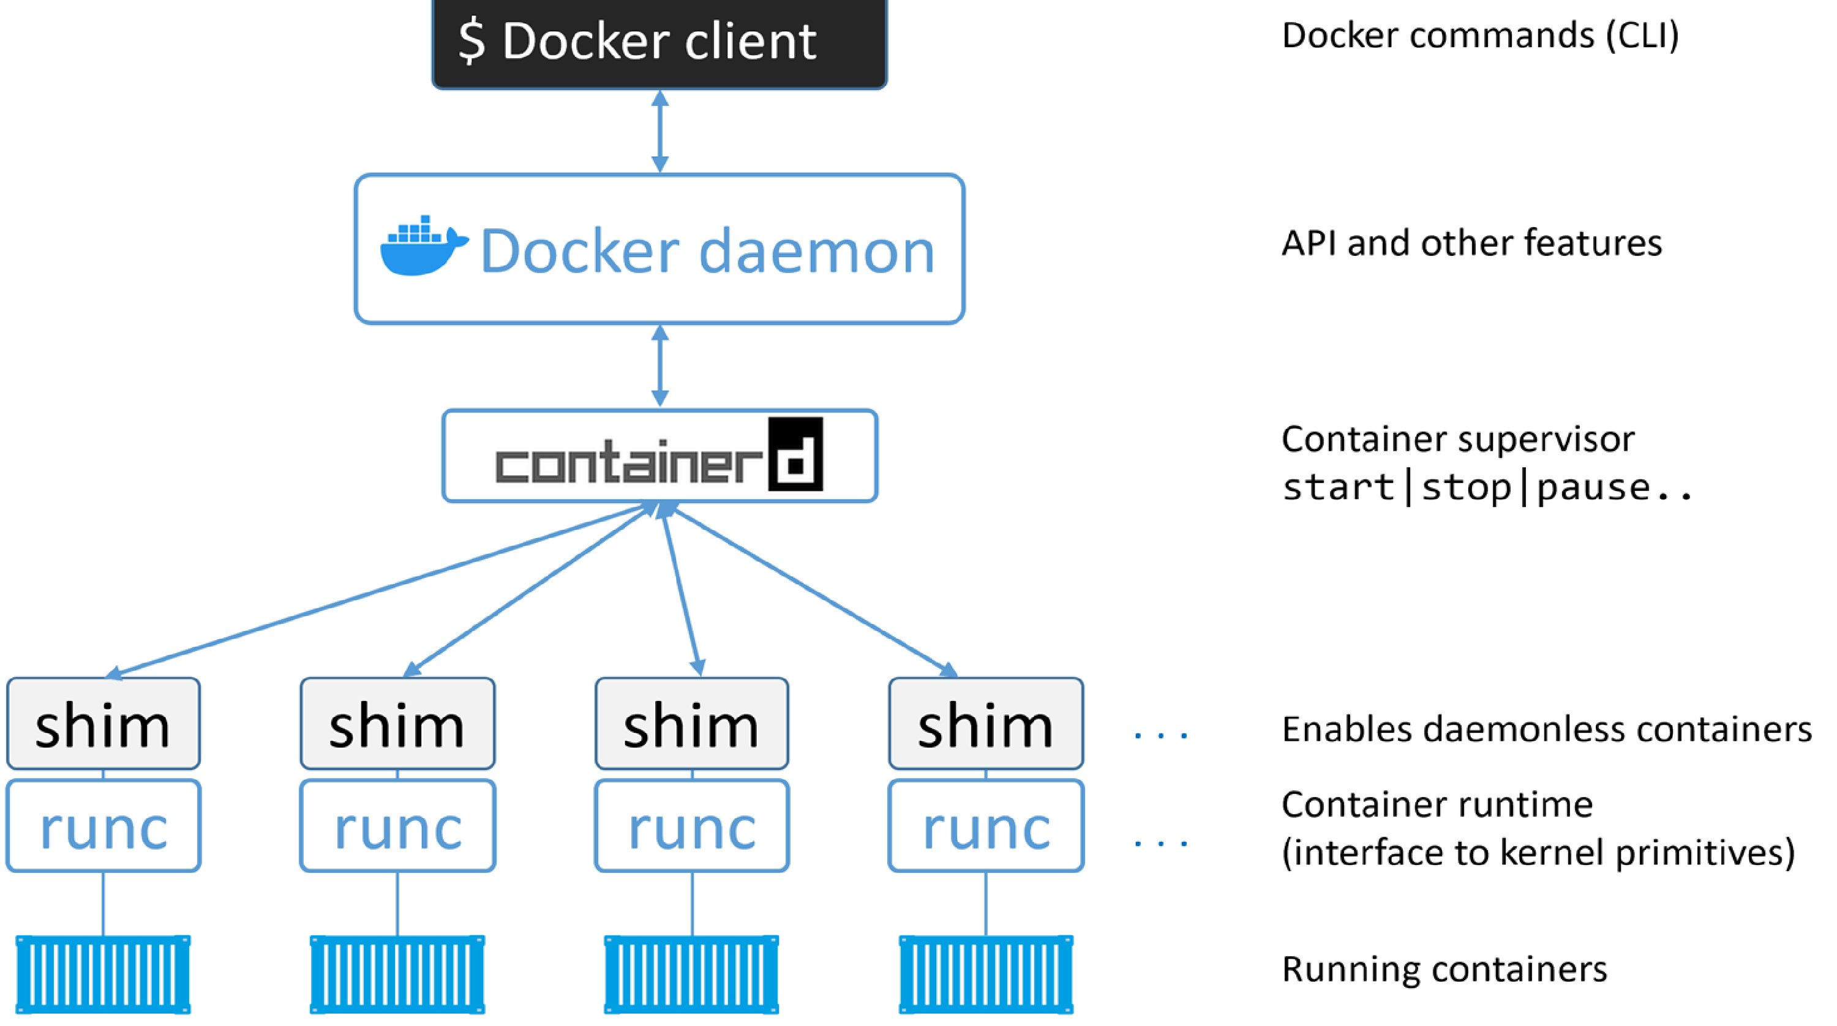

Slide 10
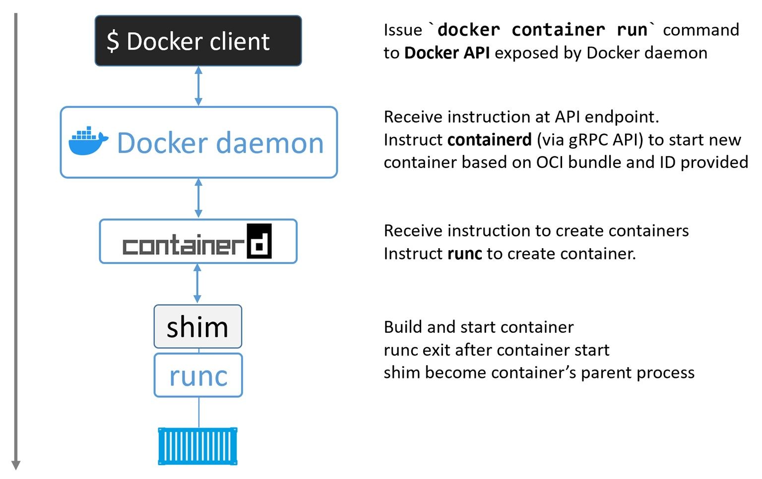

Slide 11
Securing client and daemon communication

Slide 12
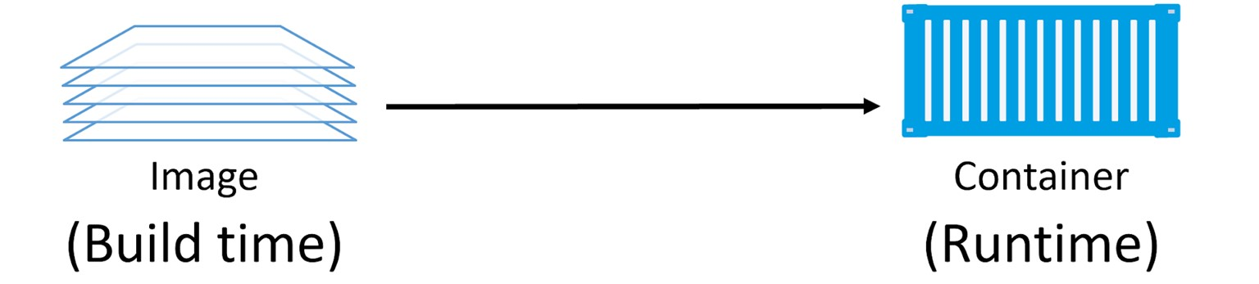
Docker Images
Read-only template that contains a set of instructions for creating a container that can run on the Docker platform.

Slide 13
Images and layers

Slide 14
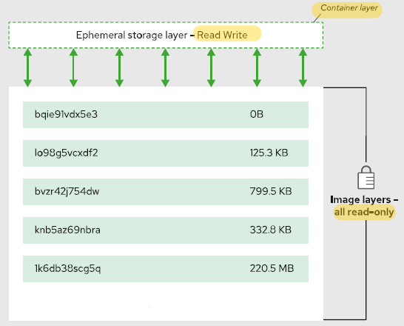
Images and layers

Slide 15
Image Registries
Docker-hub

Slide 16
Docker Containers

Slide 17
Self-healing containers with restart policies
Always
container will always restart if the main process is killed from inside the container but won't restart if you manually stopped it. Will restart if the Docker daemon restarts
unless-stopped
container will always restart if the main process is killed from inside the container but won't restart if you manually stopped it. However will NOT restart if the Docker daemon restarts.
on-failure
container will always restart if the main process exits with non-zero code (i.e. with error) but won't restart if you manually stopped it. However will NOT restart if the Docker daemon restarts

Slide 18
Install Docker
How To Install Docker
Docker-hub

Slide 19
Images Commands
docker images shows all images.
docker rmi removes an image.
docker search image search
docker history shows history of image.
docker tag tags an image to a name (local or registry).

Slide 20
Images Commands cont’d
docker commit creates image from a container, pausing it temporarily if it is running.
Ex: docker commit [OPTIONS] CONTAINER_ID [REPOSITORY[:TAG]]
docker save saves an image to a tar archive stream to STDOUT with all parent layers, tags & versions
Ex : sudo docker save busybox-1 > /home/save.tar
docker load loads an image from a tar archive as STDIN, including images and tags (as of 0.7).
N.B: All the above commands will require the IMAGE_ID

Slide 21
Containers Commands
docker start/stop/restart starts/stops/restarts a container.
docker run creates and starts a container in one operation.
Ex: docker run -p $HOSTPORT:$CONTAINERPORT --name CONTAINER some image
Ex: docker run –it IMAGE bash (it will open the container )
docker ps shows running containers.
docker ps -a shows running and stopped containers.
docker logs gets logs from container.

Slide 22
Containers Commands cont’d
docker inspect looks at all the info on a container (including IP address).
docker events gets events from container.
docker port shows public facing port of container.
docker top shows running processes in container.
docker stats shows containers' resource usage statistics.
docker diff shows changed files in the container's FS.

Slide 23
Containers Commands cont’d
docker export – Exports a container’s filesystem as a tar archive
Ex: docker export <CONTAINER ID> > /home/export.tar
docker import creates an image from a tarball.
docker cp copies local file to container and vice versa.
Ex: docker cp [OPTIONS] CONTAINER_ID:SRC_PATH DEST_PATH
Ex: docker cp [OPTIONS] SRC_PATH CONTAINER_ID:DEST_PATH
docker exec to execute a command inside a container.
Ex: docker exec –it CONTAINER_ID bash
N.B: All the above commands will require the CONTAINER_ID

Slide 24
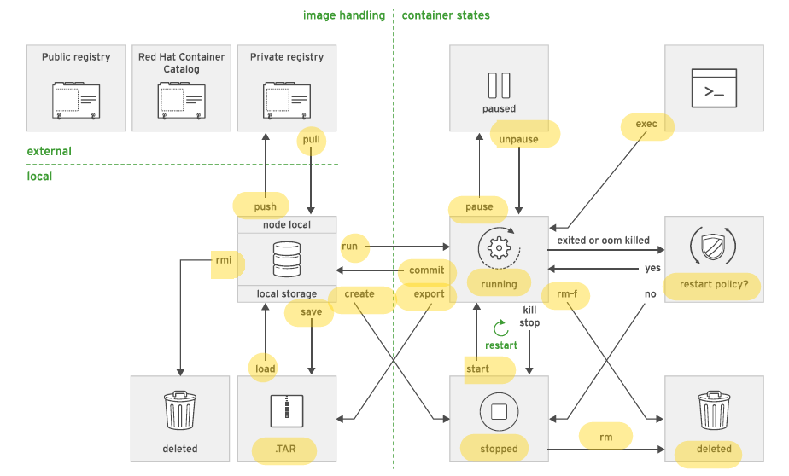

Slide 25
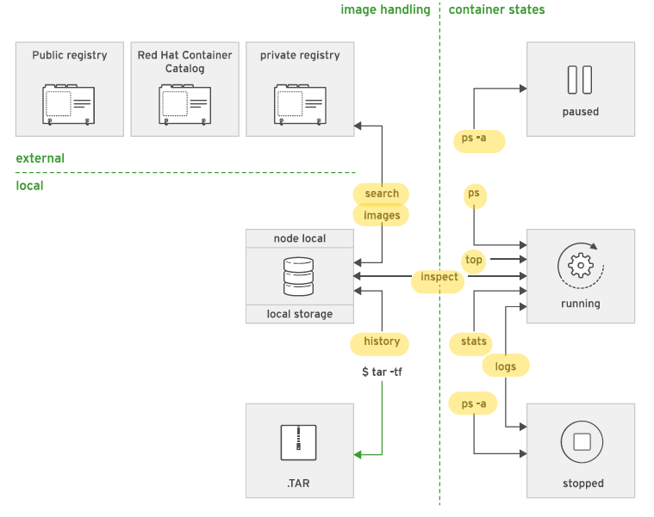

Slide 26
Docker file
Dockerfile is a script that contains instructions for building a customized docker image.
Each instruction in a Dockerfile creates a new layer in the image, and the final image is composed of all the layers stacked on top of each other
It includes instructions for installing dependencies, copying files, setting environment variables, and configuring the container

Slide 27
Docker file

Slide 28
Dockerfile basics
FROM Sets the Base Image for subsequent instructions, you should write this command at least in Dockerfile
RUN execute any commands in a new layer on top of the current image and commit the results. (Used mainly for installing packages)
CMD provide defaults for executing command inside a container.
EXPOSE informs Docker that the container listens on the specified network ports at runtime. NOTE: does not actually make ports accessible.

Slide 29
Dockerfile basics cont’d
ENV sets environment variable.
COPY copies new files or directories to container. Note that this only copies as root, so you have to chown manually regardless of your USER / WORKDIR setting. See https://github.com/moby/moby/issues/30110
ADD lets you do that too, but it also supports 2 other sources. First, you can use a URL instead of a local file / directory. Secondly, you can extract a tar file from the source directly into the destination.

Slide 30
Dockerfile basics cont’d
ENTRYPOINT configures a container that will run as an executable = CMD
VOLUME creates a mount point for externally mounted volumes or other containers.
USER sets the user name for following RUN / CMD / ENTRYPOINT commands, By default it run commands as a root
WORKDIR sets the working directory, By default it run commands in home directory.
ARG defines a build-time variable.

Slide 31
Dockerfile Sample
FROM node:14-alpine3.16 WORKDIR /app COPY . . RUN npm install CMD [ "npm", "start" ]

Slide 32
Building Docker file, tagging and creating image
Traditionally, the Dockerfile is called ”Dockerfile”
build Dockerfile > docker build .(current dictory)
build Dockerfile with image tag add “-t” > docker build –t “tag” .(current dictory)
If the Dockerfile is not named as “Dockerfile”
build Dockerfile > docker build -f /path/to/a/Dockerfile
build Dockerfile with image tag add “-t” > docker build –t “tag” -f /path/to/a/Dockerfile

Slide 33
Logging to your Docker repo from CLI
docker login “URL”
By Default, docker login > redirects login to docker hub
Enter your username and password

Slide 34
Pushing/Pulling image to docker repo
docker tag local-image:tagname remote-repo:tagname
docker push remote-repo:tagname
docker pull new-repo:tagname
Example
docker tag image-id hossamesaaa/firstproject:hossam
docker push hossamesaaa/firstproject:hossam
docker pull hossamesaaa/firstproject:hossam

